Slide 1
Material Handling Systems
CH # 5

Slide 2
Material Handling Equipment
Between fixed points over a fixed path
Belt conveyor
Roller conveyor
Chute conveyor
Slat conveyor
Screw conveyor
Chain conveyor
Overhead monorail conveyor
Trolley conveyor
Wheel conveyor
Tow conveyor
Bucket conveyor
Cart-on-track conveyor
Pneumatic tube conveyor

Slide 3
Material Handling Equipment
Over limited areas
Hoists
Overhead cranes
Hydraulic scissors lift
Over large areas
Handcart/truck
Tier platform truck
Hand lift truck / pallet jack
Power-driven hand truck
Power-driven platform truck
Forklift truck
Narrow aisle truck
Tractor-trailer truck
Material lift
Drum truck
Drum lifter
Dolly
Automated guided vehicle system

Slide 4
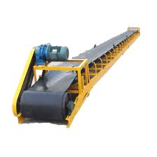
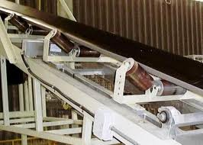
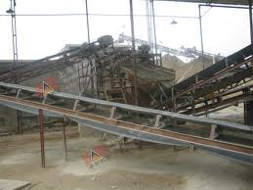
Belt conveyor

Slide 5
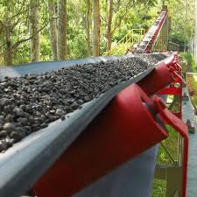
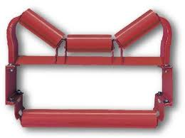
Belt conveyor

Slide 6
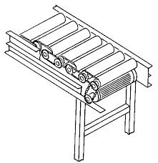
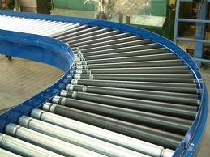
Roller conveyor

Slide 7
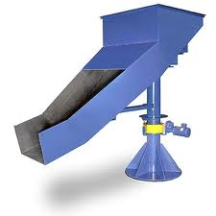
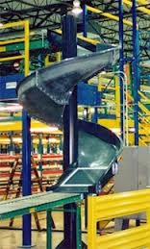
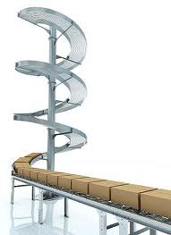
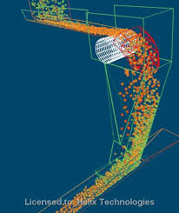
Chute conveyor

Slide 8
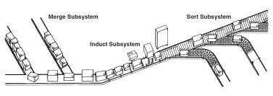
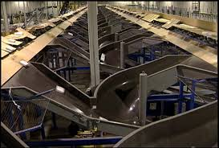
Chute conveyor

Slide 9
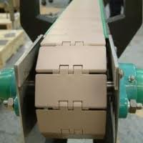
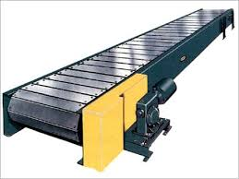
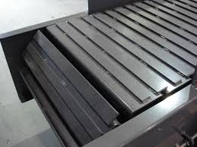
Slat conveyor

Slide 10
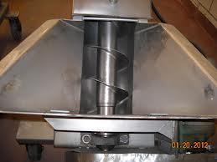
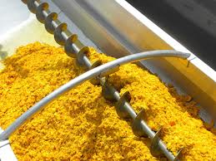
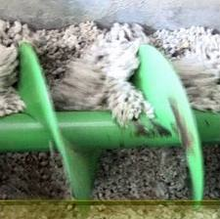
Screw conveyor

Slide 11
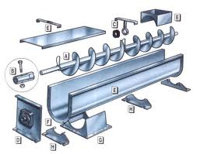
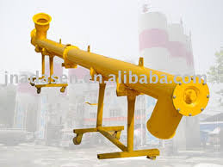
Screw conveyor

Slide 12
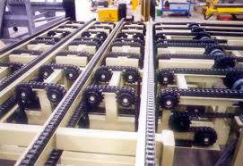
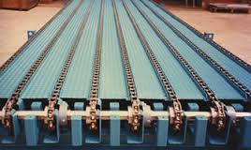
Chain conveyor

Slide 13
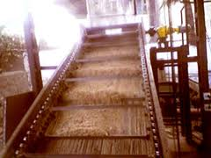
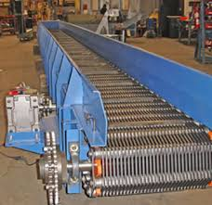
Chain conveyor

Slide 14
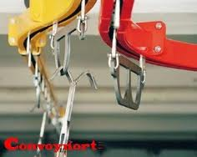
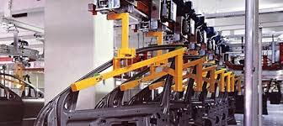
Overhead monorail conveyor

Slide 15
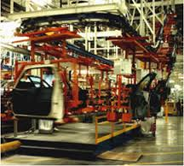
Overhead monorail conveyor

Slide 16
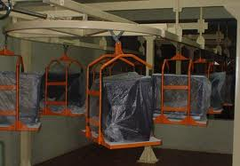
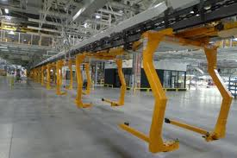
Trolley conveyor

Slide 17
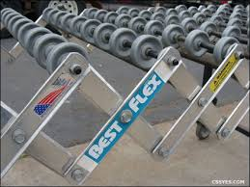
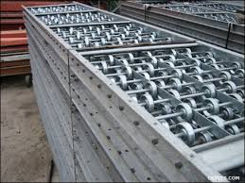
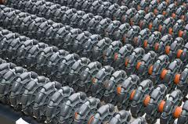
Wheel conveyor

Slide 18
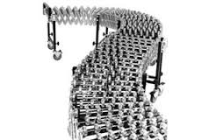
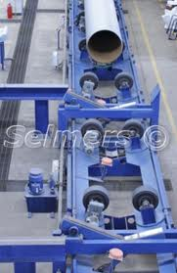
Wheel conveyor

Slide 19
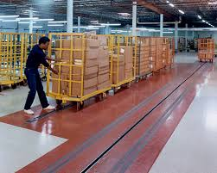
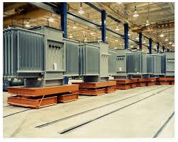
Tow conveyor

Slide 20
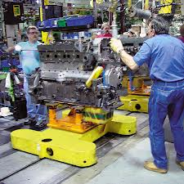
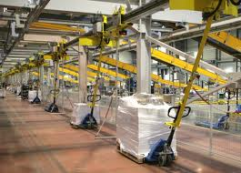
Tow conveyor

Slide 21
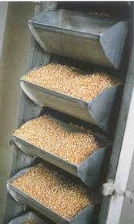
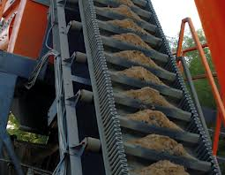
Bucket conveyor

Slide 22
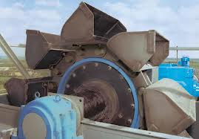
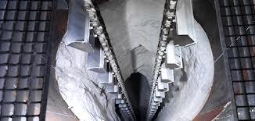
Bucket conveyor

Slide 23
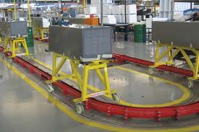
Cart-on-track conveyor

Slide 24
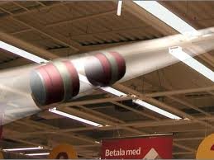
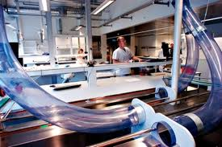
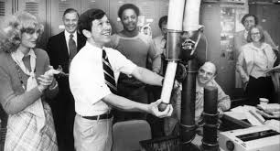
Pneumatic tube conveyor

Slide 25
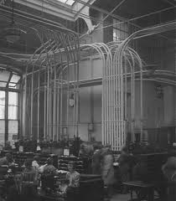
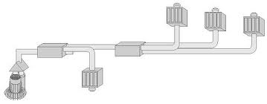
Pneumatic tube conveyor

Slide 26
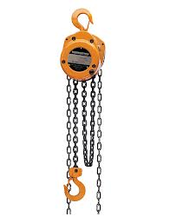

Hoists

Slide 27


Overhead cranes

Slide 28


Hydraulic scissors lift

Slide 29




Handcart/truck

Slide 30






Tier platform truck

Slide 31




Hand lift truck / pallet jack

Slide 32
Power-driven hand truck

Slide 33

Power-driven platform truck

Slide 34

Forklift truck

Slide 35


Narrow aisle truck

Slide 36

Tractor-trailer truck

Slide 37





Material lift

Slide 38

Drum truck

Slide 39



Drum lifter

Slide 40



Drum lifter

Slide 41

Dolly

Slide 42



Pallet

Slide 43




Tote Pan

